Slide 1
Chengdu AV-EV Engineering Center: Battery Management System Development Simcenter Engineering and Consulting, 06/05/2020
June 2020
Realize Innovation

Slide 2
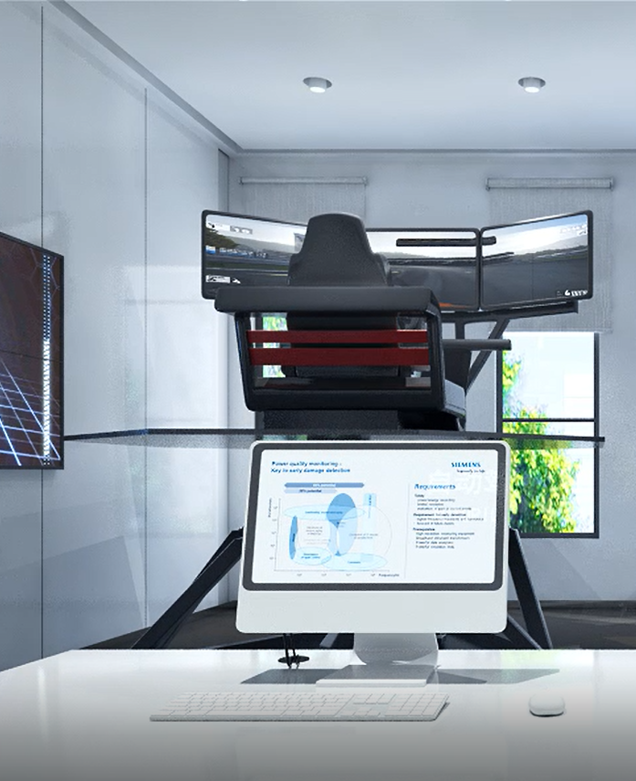
Document Outline
Project Overview and Introduction to BMS
BMS Development V Diagram
BMS Architecture
Polarion for System Engineering
BMS Development 1: Control Dev and Open Loop Testing
BMS Development 2: Model based Closed Loop Testing
BMS Development 3.: Software in the Loop Testing
BMS Development 4.: RPC Testing with Labjack

Slide 3
Project Overview Project Context and Target
Setup end-to-end workflow to demonstrate the development of Battery Management System (BMS) algorithms and software on a virtual battery pack
Process orchestration using Polarion
Requirements and Test Cases organization and management using Polarion
Battery cell and pack models implemented in Simcenter Amesim to test and verify the BMS algorithm and software
BMS algorithms implemented as control logic in MATLAB/Simulink and its verification testing executed using MIL simulation
Embedded application C-code generated from the algorithm model using auto code generation technology and SIL based tests executed to verify functionality.
Implement the developed BMS algorithm software on a Rapid Prototyping Electronic Control Unit (RPC)
This BMS controller can be used on the HIL bench planned for the second phase of the BMS demonstrator.

Slide 4
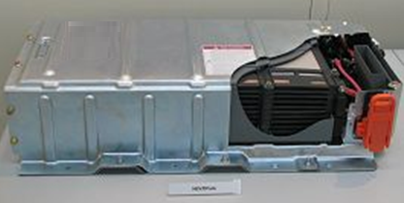
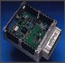
BMS System Closed Loop Overview
Controller
Battery Pack (Plant)
ECU
Micro Processor
Embedded Software
I/O Hardware
Vehicle Commands
actuators
sensor
Objectives: Control system is required to
Monitor pack current, voltages, temperatures
Control battery temperature to desired range
Determine state of charge and available energy (fuel gauge), state of health and power limits
Keep cells within safe operating ranges to prevent damage and abuse and prolong the cell life
Fulfill functional requirements of the application in which it is used

Slide 5
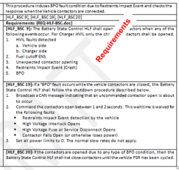
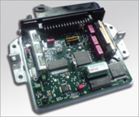

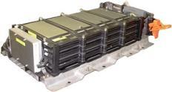
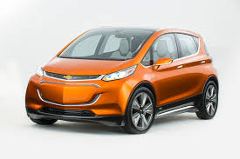
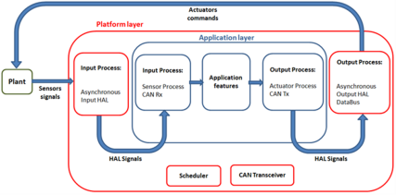
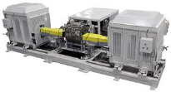
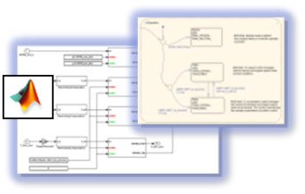
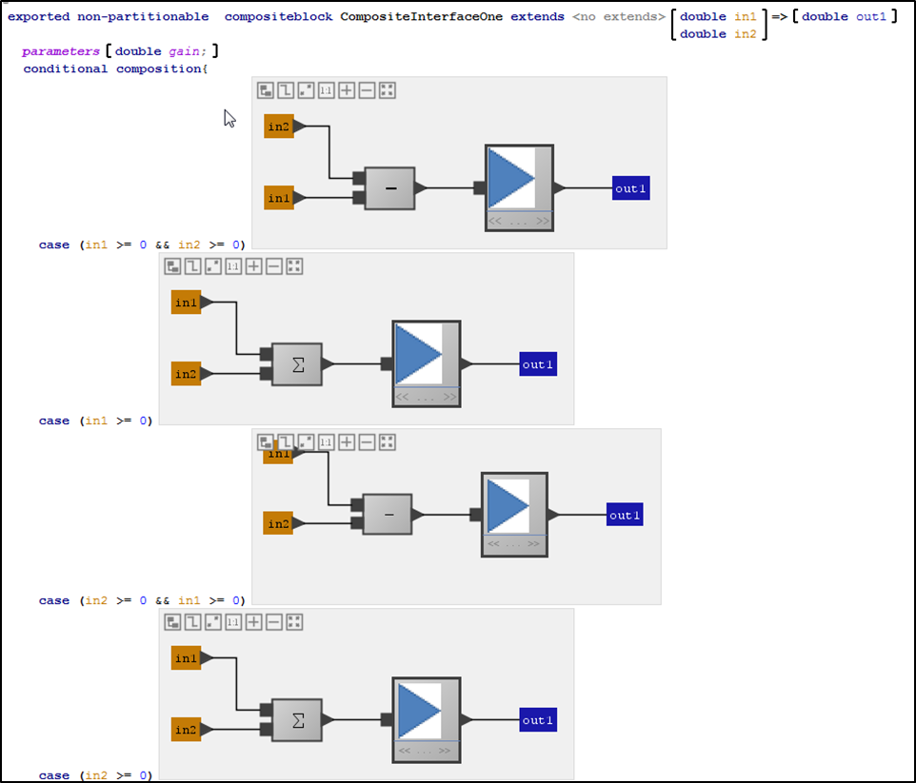

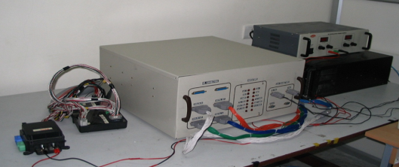
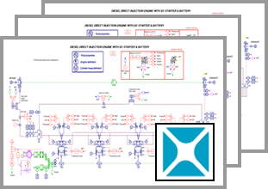
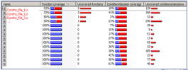
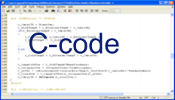

MBSE Development Process for BMS
More effort spent upstream to reduce later re-work
ECU Requirements and Change Requests
Requirements analysis
Vehicle integration & testing
Architecture Partitioning
Algorithm Specification development
Powertrain system testing
Style Guides, Blocksets and Style Checkers
MIL
HIL
ESD
Model based algorithm testing
(MIL)
Open-Loop & Closed-Loop Testing; Automated Testing
ECU System integration bench testing
SIL
Different levels of plant models to test different control features
Repeat Open-Loop & Closed-Loop Testing; Automated Testing
Integration with legacy C-code for application build
Coverage based Test Quality enhancements
Code-generation

Slide 6
BMS System Architecture
Software
Battery Management System Layer (Software Features)
Low Voltage Battery Control (cell balancing)
Battery V-I-T Monitoring and Diagnostics
State and Mode Control
Contactor Control
Thermal controller
SOC
SOP
SOH
Virtual I/O Layer
Virtual RTOS Layer
I/O Layer
RTOS Layer
Low-Level Drivers
Low-Level Drivers
Hardware Layer

Slide 7
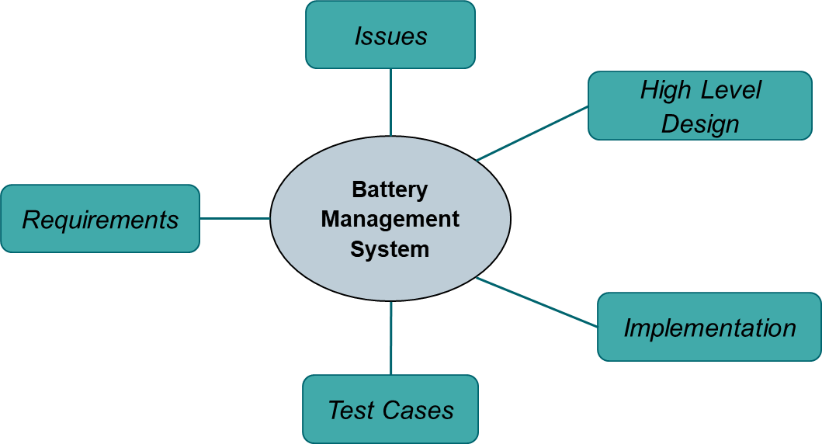

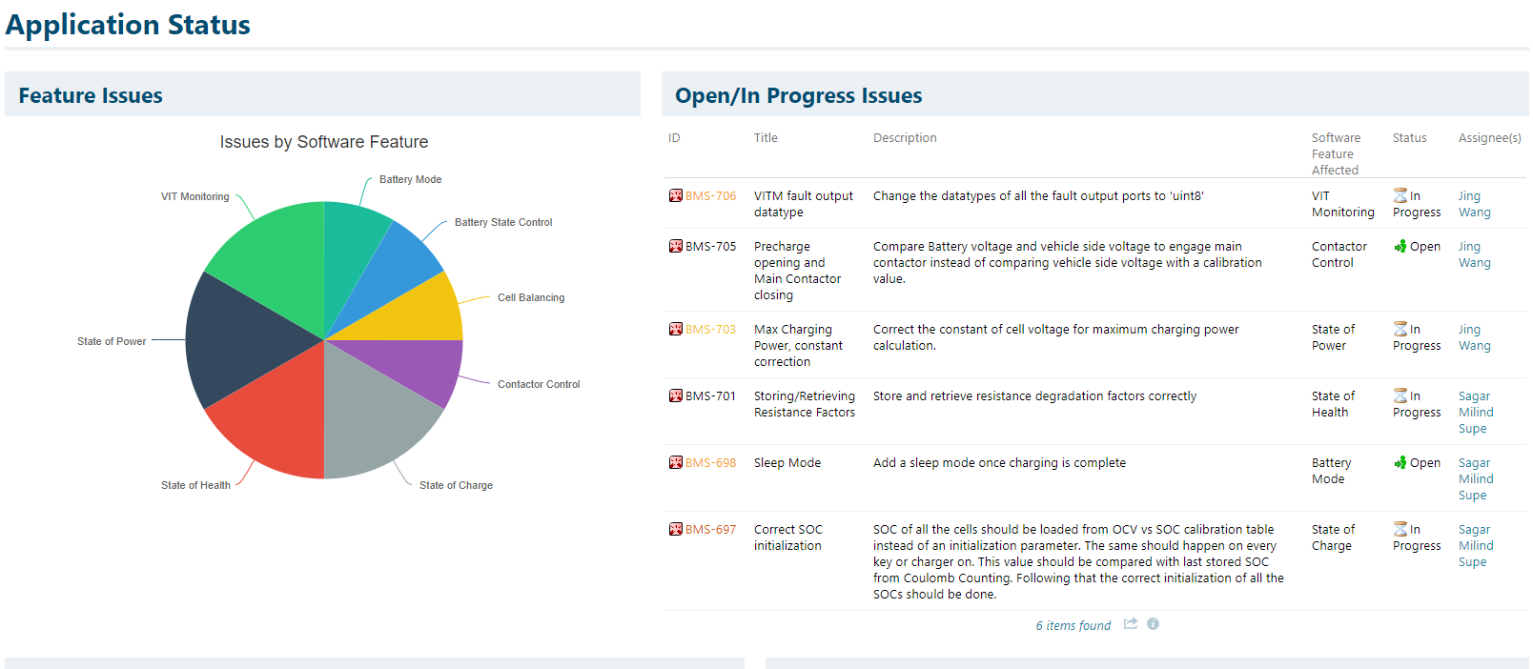
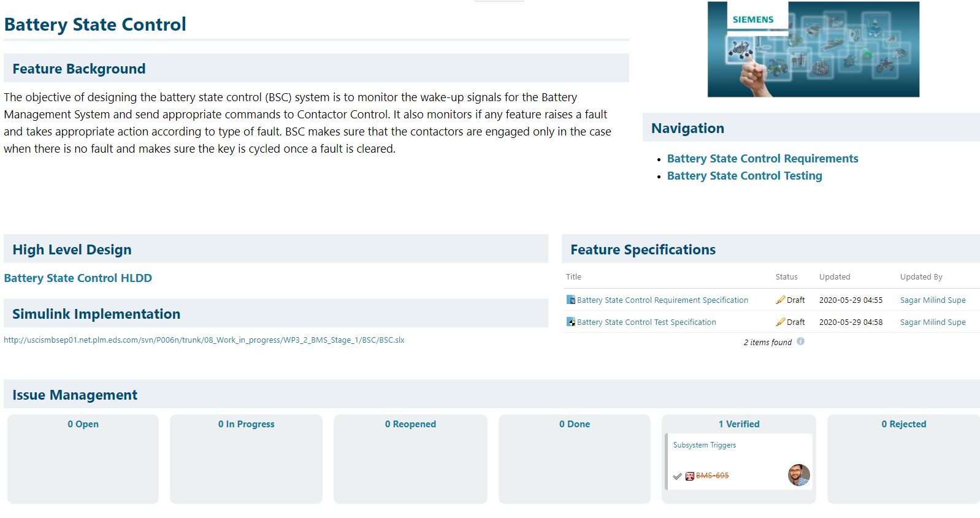
Managing the Software Development Artifacts Polarion for BMS Development
Siemens utilized Polarion ALM during the development of the Battery Management System
Utilizing Polarion ALM allowed software engineers the ability to efficiently manage software development artifacts, maintain detailed traceability between artifacts, and quickly conduct impact analysis across the application.
Development artifacts stored in Polarion
Polarion application level: software dev status, solved/in progress issues tracking, etc
Polarion software feature level: high level functional document, requirements, test cases, Simulink model, test results, issues tracking, etc

Slide 8
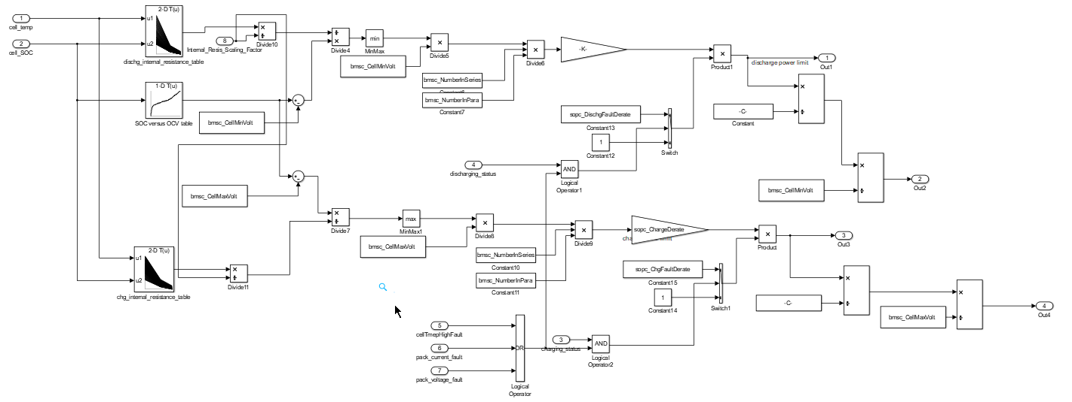
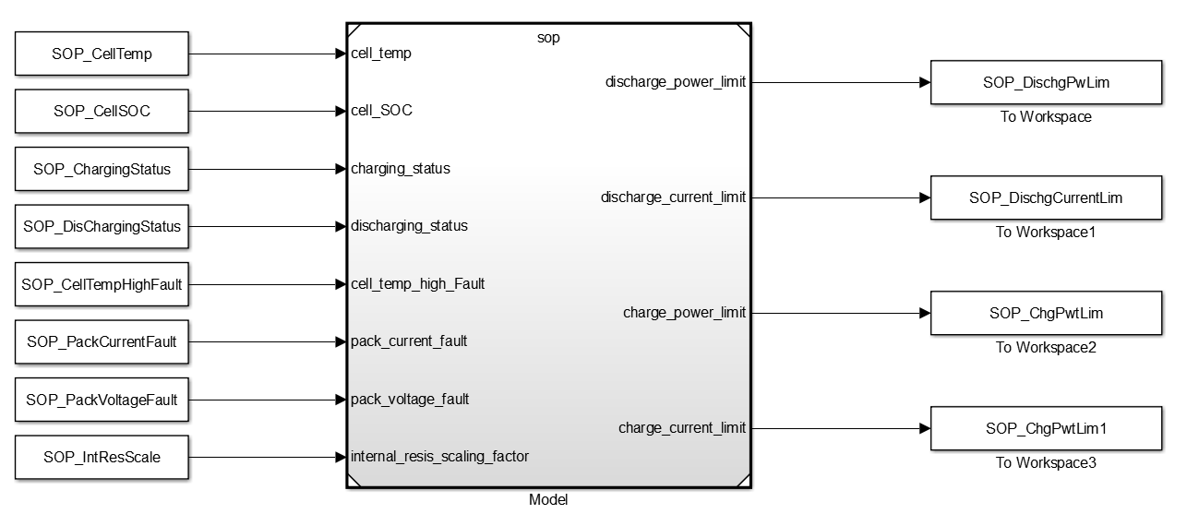
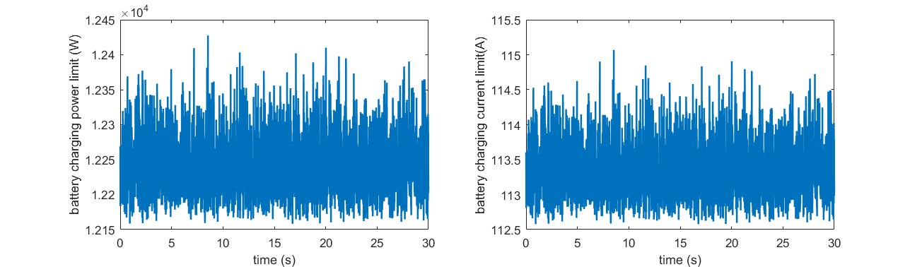
BMS Development Step 1: Simulink model development and Open Loop Testing
Functional High Level Documentation
Test Cases
Requirements
Simulink model for State of Power (SOP)
Open Loop Testing Harness (SOP)
Test Results
Create Simulink model for each BMS feature according to high level feature functionality document
Create open loop testing harness for open loop testing of each feature
Requirements define various test cases associated with each feature
Test cases will be used to generate appropriate inputs for open loop testing
Example :Discharging power limit
and current limit

Slide 9
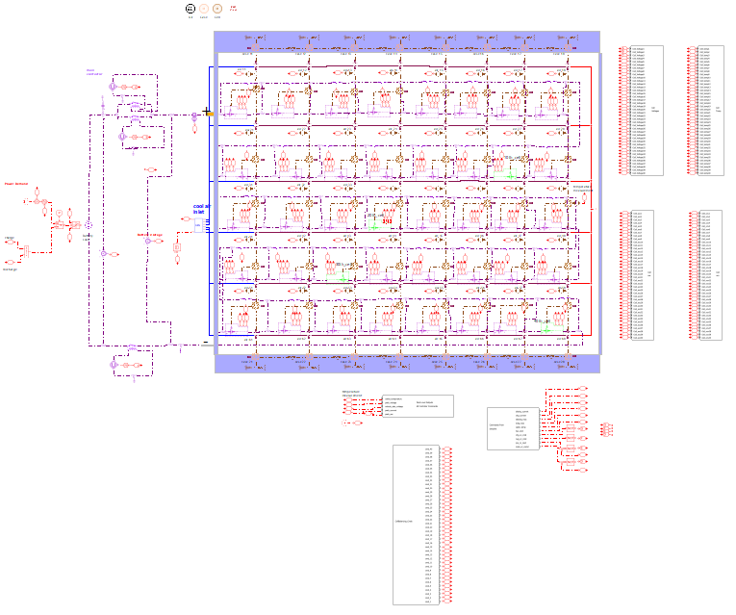
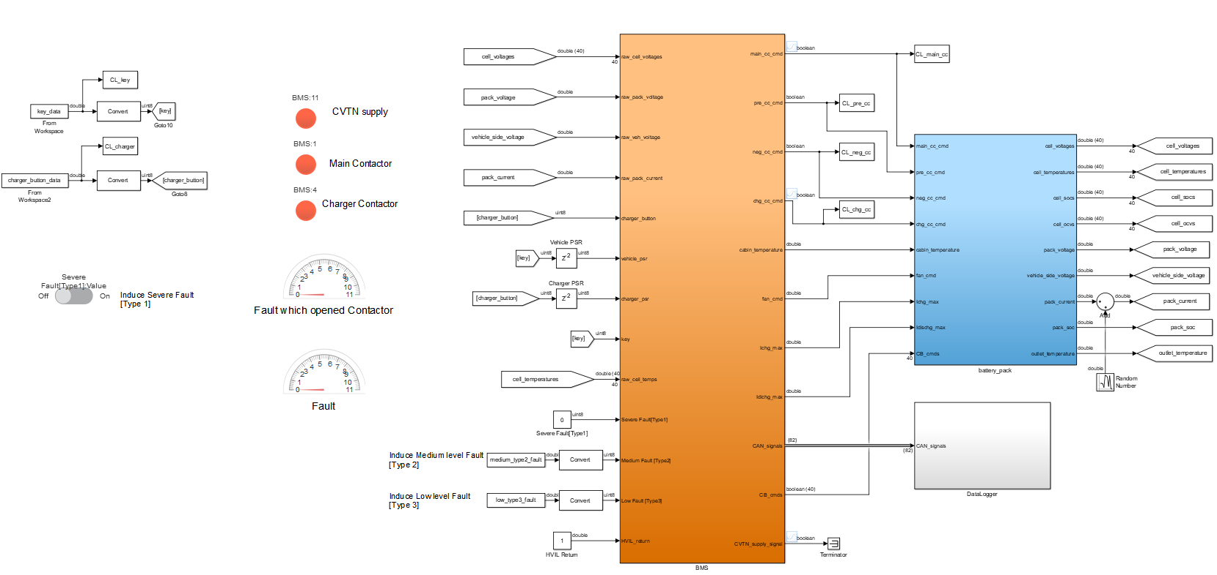
Amesim Battery Model for MIL and SIL
Battery pack model
Power cycle Input
Contactor model:
Precharge contactor
Main contactor
Charger contactor
Battery model in Simulink
Amesim/Simulink Interface

Slide 10
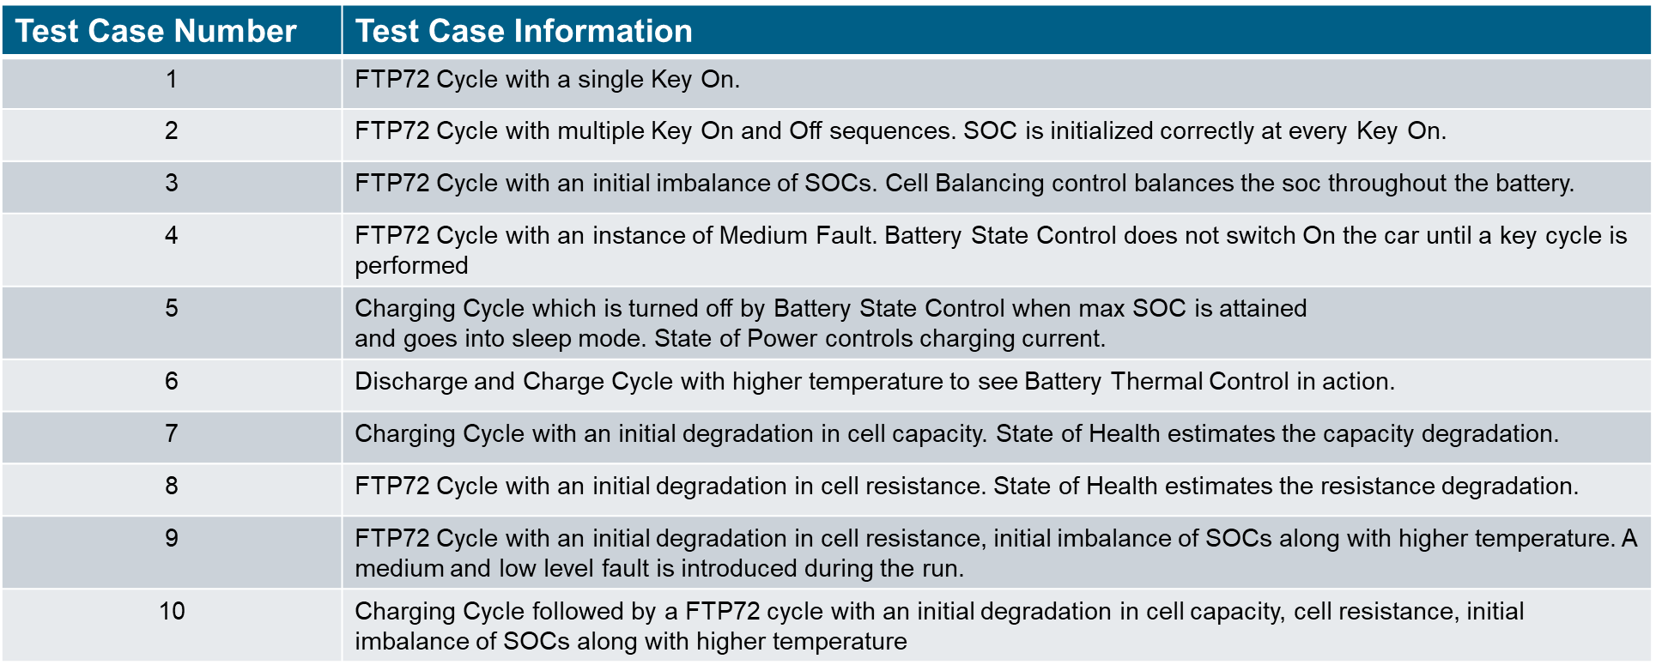
BMS Development Step 2: Simulink model Closed Loop Testing with Amesim Battery Model
Key and Charger Signals
BMS
Feedback Displays
Amesim Battery Model
10 test cases for closed loop testing
Data Logger

Slide 11
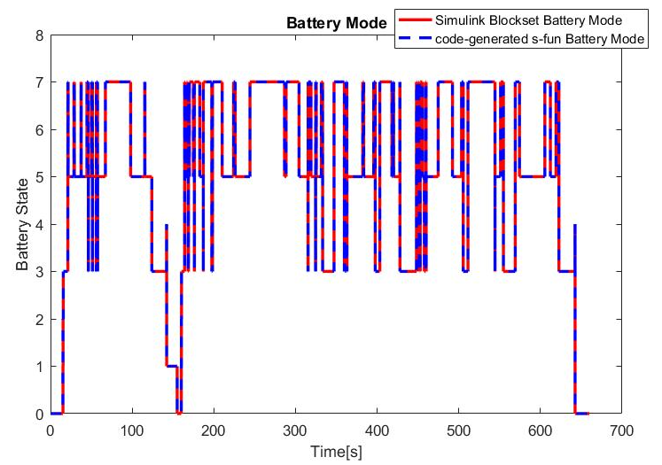
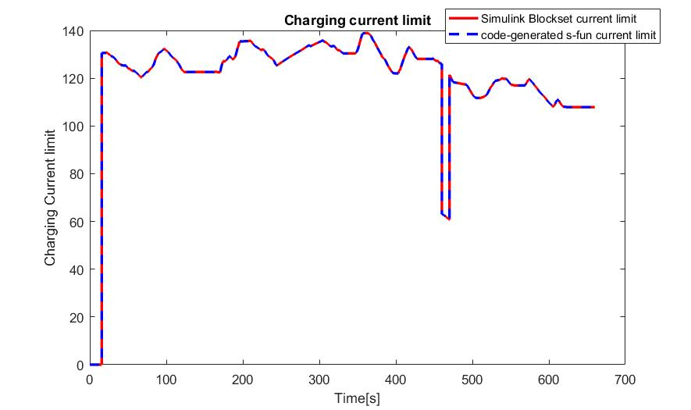
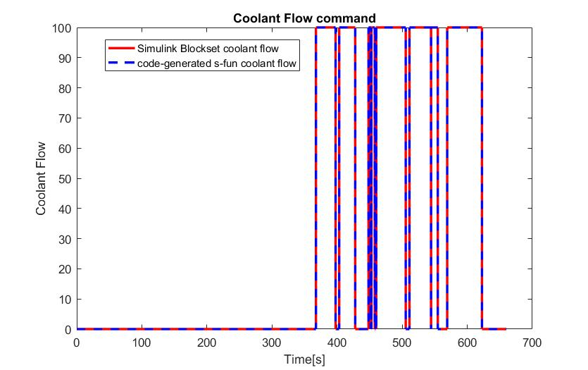
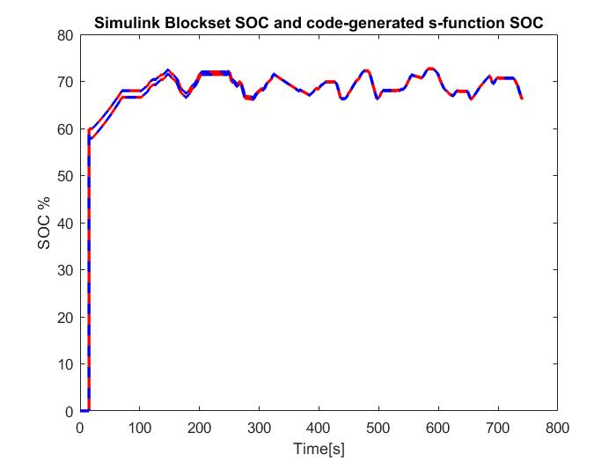
BMS Development Step 3: Software in the Loop Testing with Amesim Battery Model
Amesim Battery Model
BMS Simulink
Code
Software in the Loop Testing in Simulink Environment
10 test cases for SIL testing
Test results compare with
Simulink Code results

Slide 12
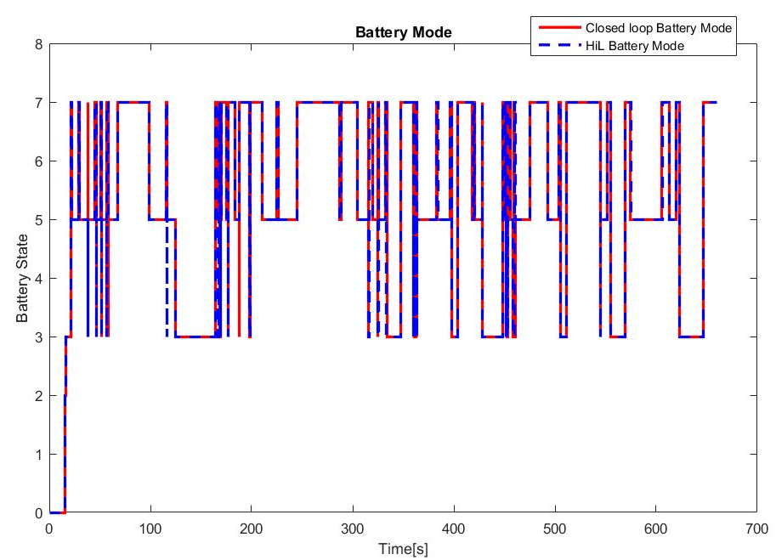
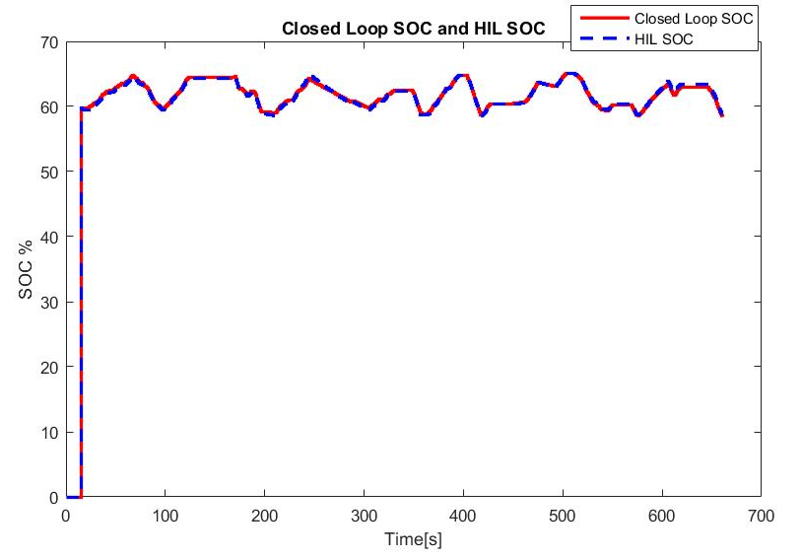
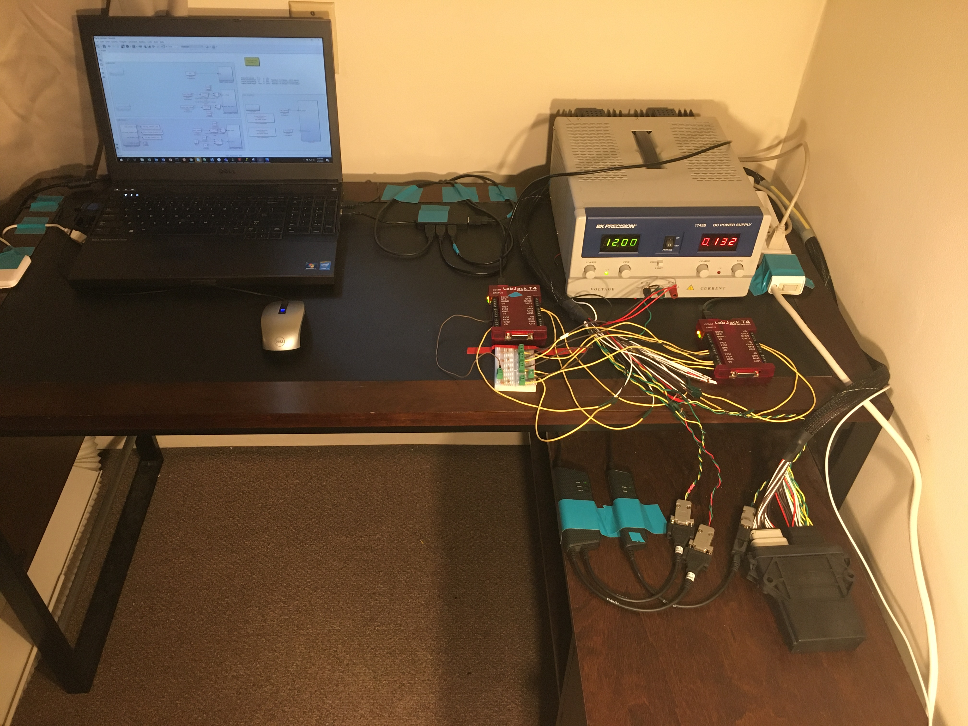
BMS Development Step 4: Rapid Prototyping Control (RPC) Unit Testing Setup
Labjack can generate analog, digital, and CAN signals like a battery pack for open loop testing of RPC
Labjack signal generator board
Testing Results Example
USB connection
Analog/Digital connection
CAN Communication
Power supply
Laptop computer for development & communication
PC can be used for code generation and flashing/logging RPC, and download signals to Labjack boards
RPC: PI Innovo M110
RPC contains 3 CAN channels and multiple analog/digital pins suitable for BMS application

Slide 13
Thank You
Realize innovation.
Restricted © Siemens AG 2019

